Slide 1
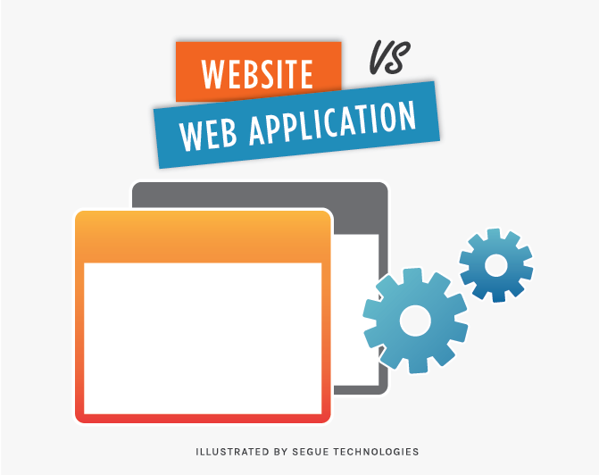
A website is informational
A web application is interactive

Slide 2
Advantages and disadvantage of web application
Advantages:
1. Good separation mode
2. Reduce server pressure
3. Share a set of back-end program code
Disadvantages:
1. SEO is difficult
Difficult to manage
3. The initial loading takes much time

Slide 3

History of Web Development
1969 ARPANET
1981 The first complete norm had been established base on TCP/IP
1982 WAN appeared in Europe
1984 DNS technique realized; e-mail came into use in Germany
1985 The first domain name Symbolics.com appeared
1987-1989 3 service providers : UNNET CERFNET PSINET; Tim Berners-Lee established WWW and started to explore HTTP
1990 The first network search engine Archie appeared
1991 WWW opened to the public; Gopher
1994-2006 Netscape ,Yahoo! ,Craigslist,eBay,AltaVista,Google,WordPress,Facebook,Youtube.com,Reddit,Twitter
2016 Google Analysis(AI)
2018----

Slide 4
How to develop web
Learning to use a flow chart software (MS Visio, Xmind)
Being familiar with website structure
Learning a Photo Processing Software (PS)
Learning basic Internet knowledge
Learning HTML and CSS

Slide 5
web's future
First,web will let everybody get online.
Second,web will bring more innovation.
Third,web will provide more work chances with people.

Slide 6
thank you for listenning

